Slide 1


Individual Research Project
DataWise

Slide 2
Presentation Plan
I – Literature review
Edge computing
ATM challenges
FL challenges
Proposed improvements to FL & ATM systems
ASTERIX data formats
II – Next steps & challenges

Slide 3
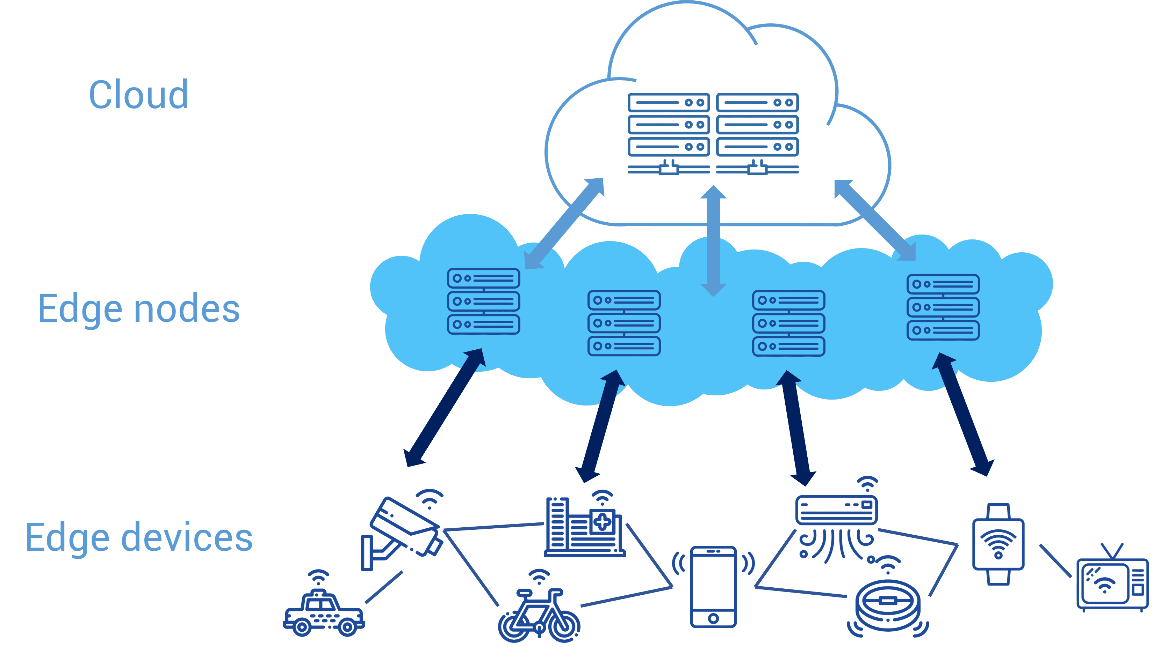
Edge Computing
Process the data near the data source
Send only the processed and reduced data to the cloud / central server
Mostly for connected devices and their numerous sensors

Slide 4
ATM challenges
Increasing data storage volumes (100TB/year & rising)
→ Exponential growth predicted because of different kinds of aircrafts are expected (drones)
Increasing query time
→ Indexes larger than datasets
→ Threat to airspace security
Data accuracy
→ Sensor inaccuracy
→ Communication failures

Slide 5
ADS-BI to tackle both challenges
Improved data storage and retrieval through spatio-temporal partitioning
Reduced query response time with a novel DB indexing method
Data compression system exploiting similarities within each block as well as patterns emerging among different blocks.

Slide 6
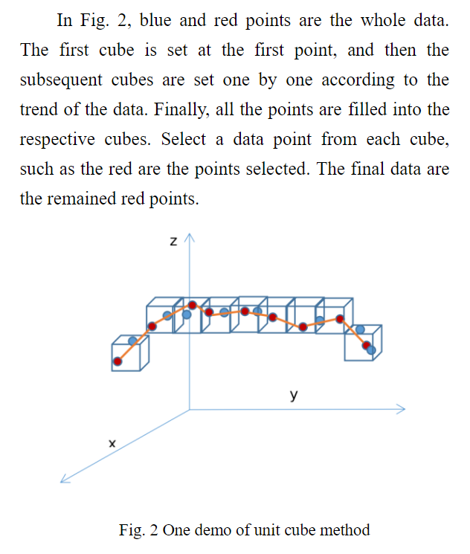
4D-data cleansing
Solutions:
Newton interpolation for missing data
Simple dense NN for noise cancellation
DBSCAN clustering to find outliers
“Unit cube sampling”
Common errors: missing, duplicated or false (spatial or chronological) data

Slide 7
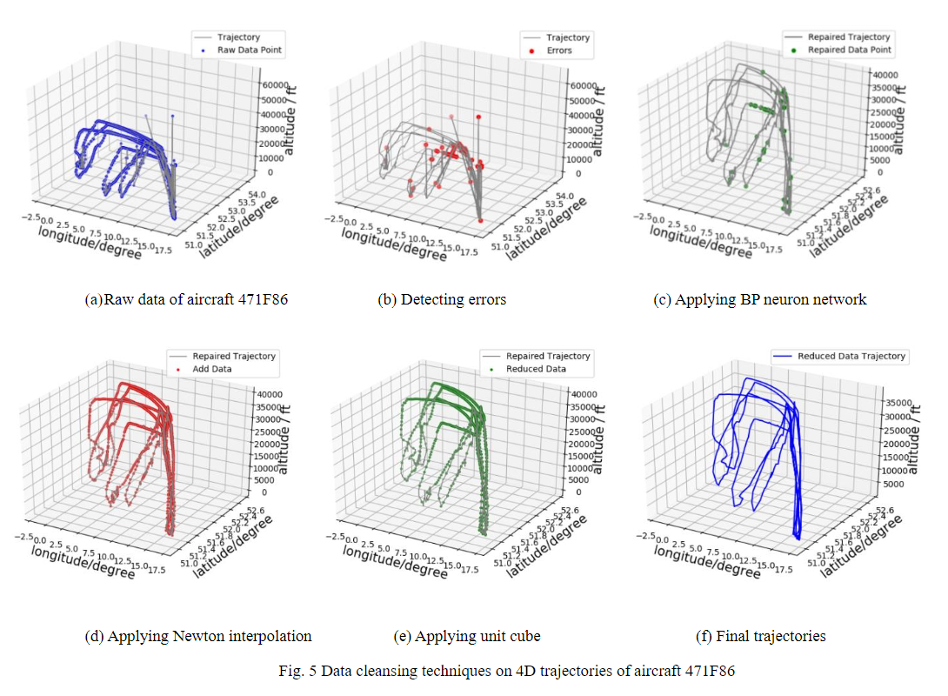
Performance on real data

Slide 8
Challenges associated with FL
4 main challenges
Expensive communications
Systems heterogeneity
Statistical heterogeneity
Privacy concerns

Slide 9
Potential solutions to improve FL frameworks
Sparsification / Discretization of weights updates
Reduced update communication frequency
Low-rank weight matrix (U = A.B where A is a random rectangular matrix and B is a compatible rectangular matrix; we train B)
Lossy compression of updates

Slide 10
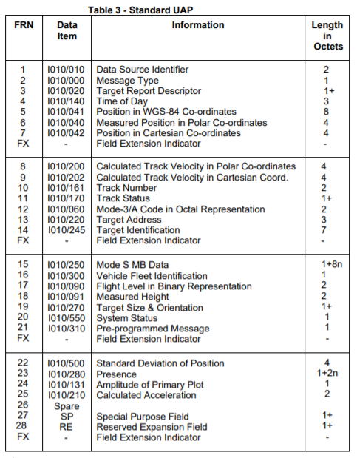
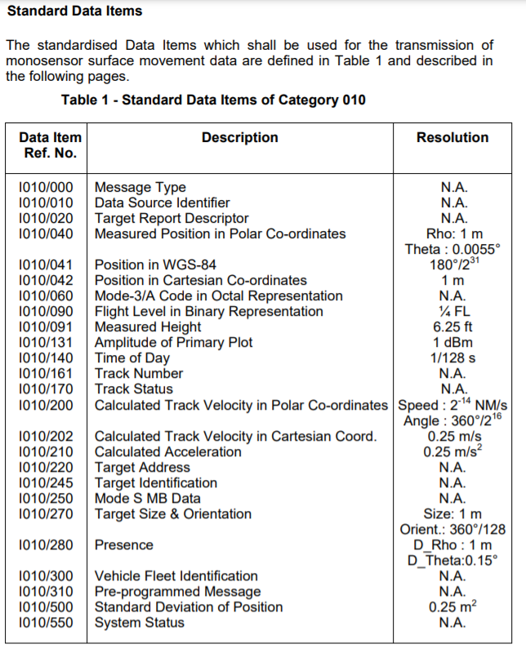
ASTERIX data formats (ex: CAT010)
CAT010: Surface movement detected from ground radars

Slide 11
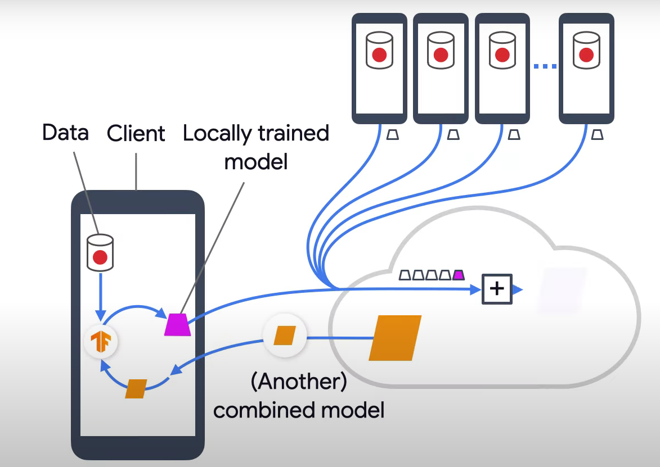
Federated learning
Google uses FL to improve user experience on smartphones

Slide 12
Federated learning
Pros :
Data privacy
Less data transfers
Can improve user experience
Cons :
Possible bottleneck effect on central server
Non-iid datasets may distort the final model

Slide 13
Variants of Federated Learning
Decentralized FL : No central server ; nodes coordinate themselves to choose the model ; transfer of trained model to randomly selected nodes
Heterogeneous FL : Nodes vary in nature (computing power, dataset features or observations, communication protocol...)

Slide 14
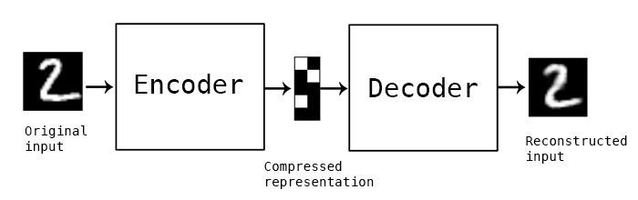
Auto encoders - decoders
Neural Network used to compress and decompress data
« Hourglass » architecture
In our context, the central server could choose an encoder-decoder architecture depending on the volumes of data to be transmitted. Once the final model is obtained, the server sends it to all planes, which use it to encode the data, while the server uses it to decode it.
Encoder-decoder on MNIST dataset

Slide 15
FL framework applied to our context
For Air-ground data transfer:
The ground station monitors a specific bounding box
If a critical number of aircrafts in the BB is reached, the GS chooses an encoder-decoder model adapted to the expected amount of data to be transmitted. The more data expected, the more important the compression ratio
The FL process is applied to the aircrafts in the BB (with improvements found in the literature)
The aircrafts use the encoder to send info and the GS to decode it.

Slide 16
Auto encoders - decoders
Neural Network used to compress and decompress data
« Hourglass » architecture
In our context, the central server could choose an encoder-decoder architecture depending on the volumes of data to be transmitted. Once the final model is obtained, the server sends it to all planes, which use it to encode the data, while the server uses it to decode it.
Encoder-decoder on MNIST dataset

Slide 17
Challenges & Questions
Make sure that air-ground data transfers of ML models aren’t more demanding on bandwidth than existing simple data transfers
Find a way to experiment (programming framework to model multiple aircrafts and their communication needs…)
-What is expected about ASTERIX documentation ?
-Meeting with NATS mid-May ? What are the expected advancements ?
-GANTT ?

Slide 18
Ideas 1
Ground station has a 4D trajectory NN predictor.
Before the start of the flight, the GS runs the NN which predicts the expected trajectory of the aircraft as a sequence of 4D points, evenly spaced in time
The GS sends the trajectory to the aircraft, which saves it in its memory
During the flight, instead of sending ADS-B data, the airplane compares the unsent ADS-B message with the trajectory.
If the message is similar to the prediction (e.g. the difference is under a certain threshold), the message is not sent. Else, if the error can pause a threat to airspace security, the message is sent.
If rectifications can be made, the prediction adjusts on both ends to resume message-less flight. Else, ADS-B communication resumes until perturbations end.

